Slide 1
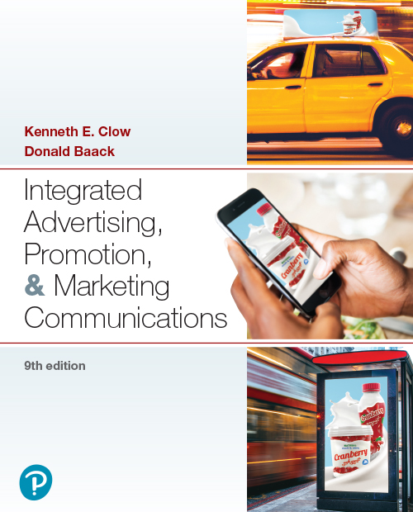

Integrated Advertising, Promotion, and Marketing Communications
Ninth Edition
Chapter 3
Buyer Behaviors
Copyright © 2022, 2018, 2016 Pearson Education, Inc. All Rights Reserved
Notes:
If this PowerPoint presentation contains mathematical equations, you may need to check that your computer has the following installed:
1) MathType Plugin
2) Math Player (free versions available)
3) NVDA Reader (free versions available)

Slide 2
Chapter Objectives (1 of 2)
3.1 Which elements are involved in internal and external information searches by consumers, as part of the purchasing process?
3.2 What three models explain how individuals evaluate purchasing alternatives?
3.3 What trends are affecting the consumer buying environment?
3.4 How do the roles played by various members of the buying center and the factors that influence them impact business purchases?
Notes:
These are the objectives for Chapter 3.

Slide 3
Chapter Objectives (2 of 2)
3.5 What types of business-to-business sales are made?
3.6 What are the steps of the business-to-business buying process?
3.7 How does dual channel marketing expand a company’s customer base and its sales?
3.8 How can a company overcome international differences when adapting to buying processes?
Notes:
These are additional objectives for Chapter 3.

Slide 4
Chapter Overview
Consumer purchase process
Consumer buying environment
Recent trends in consumer behavior
Business buying center
B-to-B purchasing process
Dual channel marketing
Notes:
Chapter 3 begins with an overview of the consumer purchasing process and the consumer buying environment. Both are important in designing marketing communications. The next part of the chapter addresses current trends in consumer behavior. The last part of the chapter examines business-to-business buying behaviors. The buying center is an important part of the buying process. Often, products are introduced in the B-to-B market, then later marketed to consumers. Dual channel marketing involves marketing to both consumers and businesses.

Slide 5

Nescafé
Goal: to change coffee consumption habits in China
Nescafé instant coffee – market leader
E-commerce and social media including Weibo
White Valentine’s Day and focus on younger consumers
Notes:
Nescafé instant coffee has been the market leader for nearly two decades, but coffee consumption was primarily an urban activity. In rural China, consumption was less than five cups of coffee per year. The goal was to change this routine, from tea to coffee. The campaign focused on the internet, e-commerce, and social media. Using the microblogging service Weibo, Nescafé launched a campaign around White Valentine’s Day, in which women gave gifts to men. The goal was to generate discussions in social media, with a contest as a complementary piece of the campaign.

Slide 6
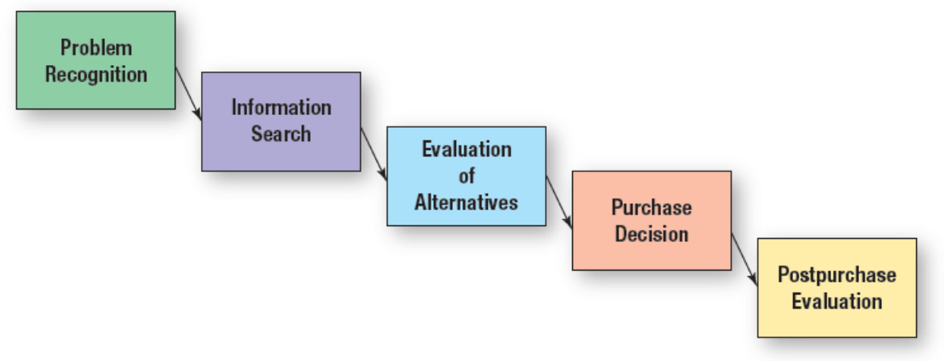
Figure 3.1: Consumer Decision-Making Process
Notes:
The consumer decision-making process involves five steps. The first step is problem recognition. It involves a consumer recognizing he/she needs something, has run out of something, or has an interest in something. Step two is information search. Consumers will first search internally for information. If they have enough information already stored in memory, then they will move to the next step. If not, then the consumer will conduct an external search. For high involvement and high dollar purchases, most consumers will conduct an external search. Step three is evaluation of alternatives. This may take only a few minutes for low cost, low involvement decisions to several months for high involvement decisions. After alternatives are evaluated, consumers will move to the next step, the purchase decision. While consumers will normally purchase the brand they intended to buy, sometimes in-store signage or deals will alter the purchase decision. The last step in the process is postpurchase evaluation. Consumers will determine the level of satisfaction with the purchase, which will impact their next purchase decision for that product.
The diagram’s flow from left to right is structured as follows.
Problem recognition
Information search
Evaluation of alternatives
Purchase decision
Post purchase evaluation

Slide 7
Information Searches and the Consumer Purchasing Process
Internal search: consumer thinks about brands to consider
External search: consumer gathers information from friends, relatives, influencers, other sources
Notes:
Once a problem, need, or want has been recognized, consumers move to the next stage of the process, information search. Understanding information search is important for marketing communications. There are two types of information search, internal and external.

Slide 8

Consumer Purchasing Process
Consumers recognize a need or want:
Physical
Social
Psychological
Can be triggered by advertising
Notes:
The first step in the consumer decision-making process is the recognition of a need or want. It can be a physical need or want, such as thirst or hunger. It can be a social need or want, such as seeing a friend with the latest cell phone or a new car. It can be a psychological need or want, such as purchasing a new outfit to wear to feel good about themselves, or because they are depressed and buying something lifts their spirits. Many purchases are triggered by running out of something, such as groceries, food, and beverages. But, advertising can also trigger a need or want. This advertisement for Skyjacker can trigger a desire for a lift kit for a vehicle. The desire can be reinforced through seeing someone else’s vehicle with one installed, or the reverse can occur.

Slide 9

Internal Search
Think about brands
Quickly reduce options
Choice based on past experience
Brand awareness and brand equity are important
Notes:
The internal search for information is a mental activity. Consumers search their memories for information. They think about brands they have purchased in the past. If the brand met their needs and the experience was good, it is very likely they will buy the same brand again. If not, they will conduct a longer internal search or move to the external search for additional information. Past experience is an important part of an internal search and how long the individual thinks about various brands. Consumers typically reduce the number of options quickly and concentrate on only a couple or small set of options. With internal search, brand awareness and brand equity are important. If a consumer is not aware of a brand, such as Kraft, then it will not be considered as a purchase option unless the search process moves to an external search. The higher the level of brand equity, the more likely the brand will be purchased with little mental effort and no additional consideration of other brands. This advertisement for Visit South Walton entices players to consider the area as the best option for a golfing vacation.

Slide 10
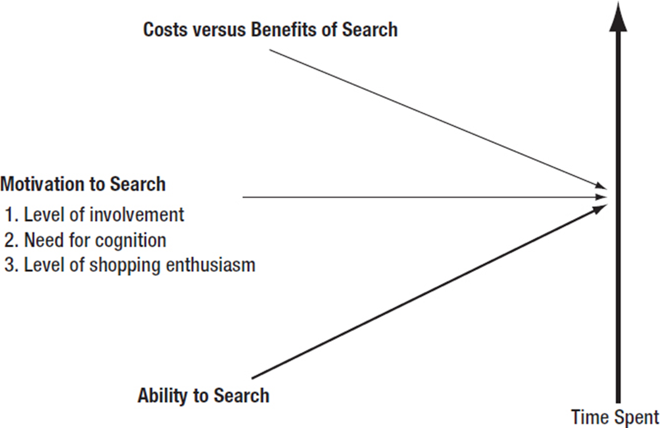
Figure 3.2: Factors Affecting the Consumer’s External Search
Notes:
The external search for information normally occurs under three conditions. First, the consumer was not happy with the last purchase experience and wants another brand or product. Second, it is a high-involvement decision, and the consumer wants more information. Third, it is a socially visible product ,and the consumer wants to make sure others will approve or be impressed with the purchase decision. The amount of time consumers spend searching for information depends on 1) their ability to search for information, 2) their level of motivation to search for information, and 3) the perceived cost of searching versus the perceived benefit of searching.
The diagram from left to right shows three right facing arrows labeled as follows:
Cost versus benefits of search
Motivation to search
Level of involvement
Need for cognition
Level of shopping enthusiasm
Ability to search

Slide 11
Ability to Search
Determines extent of search
Education level increases search time
Knowledge of product and brands affects ability
Experts may conduct extensive searches
Those who know little spend less time searching
Notes:
The ability to search for information determines the extent of the information search process. Ability consists of a person’s educational level combined with their knowledge of the product and brands. Educated individuals tend to search for more information and spend more time searching than individuals with less education. Knowledge of products and brands has an inverted U-shape curve. Individuals with little knowledge of a product category or brands tend not to search for information, primarily because they do not know where or how to search for information. They don’t know the product category well enough to know what to look for. At the other extreme, individuals with a great deal of knowledge spend less time searching since they already possess the knowledge. The group that spends the most time searching is in the middle. They have some knowledge, so they have an idea of what to look for and what to ask, but not enough knowledge to make a decision.

Slide 12

Level of Motivation
Level of involvement
Need for cognition
Level of shopping enthusiasm
Notes:
The level of motivation has an impact on the amount of time spent in external search. Motivation is determined by involvement, cognition, and shopping enthusiasm. The higher the level of involvement, the more time a consumer will spend in searching for additional information. The need for cognition is the level of mental activity a person enjoys. People who have a high need for cognition – that is, they want to think about options before making a decision – will spend more time searching for information. Some people want to weigh every option and make sure they are right, so this need to consider all angles will lengthen the search process. The last motivating factor is the person’s enthusiasm for shopping. Individuals who enjoy shopping and comparing brands will spend more time than individuals who dislike shopping. As shown in this advertisement, choosing a tuxedo for an
important event will likely be a high-involvement purchase decision.

Slide 13
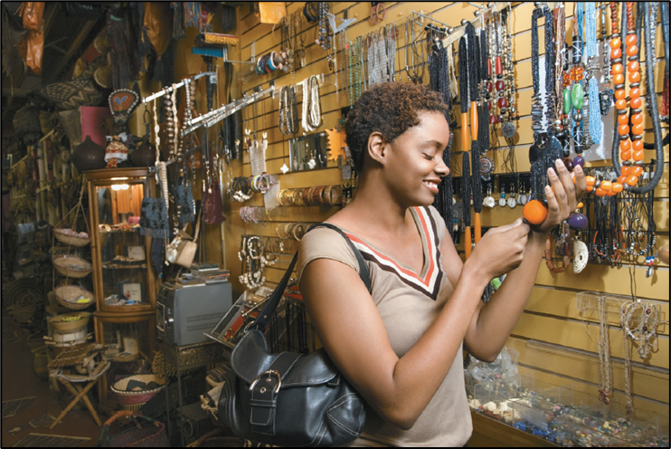
Cost versus Benefits
Actual cost
Subjective cost
Time
Anxiety
Opportunity cost
Notes:
Consumers will weigh the cost versus the benefits of an external search. There are the actual costs to search, such as driving to the mall to look at various brands. Then there is the cost of the product. If a particular brand is purchased and the consumer doesn’t like it, that money is basically lost. So, for high cost items, there is more pressure to search to make sure the right decision is made. Then there are subjective costs, the amount of time spent, and the anxiety involved. For most people, time is valuable. Yet, if the purchase decision causes anxiety, then spending more time searching for information is worth it to reduce the anxiety and ensure the right decision is made. The last consideration is opportunity cost. Once the purchase is made, the consumer forgoes the alternatives. The higher the perceived costs to search for information, the less consumers will search. Alternatively, the higher the perceived benefit in gathering additional information, the more time a person will spend searching.

Slide 14
Consumer Attitudes
Cognitive: mental images, understanding, interpretations of person, object, or issue
Affective: feelings or emotions about object, topic, or idea
Conative: intentions, actions, or behavior
Notes:
Consumer attitude can be impacted by effective marketing communications. Attitude is the mental position a person takes toward a topic, person, or an event that influences an individual’s feelings, perceptions, learning processes, and behaviors. Attitude consists of three components.
Cognitive refers to the individual’s mental images, understanding, and interpretation of the person, object, or issue.
Affective refers to the feeling and emotional part of attitude.
Conative refers to an individual's intentions, actions, or behavior.

Slide 15
Common Attitude Sequences
Cognitive → Affective → Conative
Affective → Conative → Cognitive
Conative → Cognitive → Affective
Notes:
In terms of influencing or changing consumer attitudes, marketers have three options. The most common sequence is to first impact a person’s cognitive beliefs and knowledge about a product, then develop emotions and feelings for the brand, which then results in purchasing the product. The second sequence begins with affective, the feelings and emotions. The marketing message is designed to elicit an emotional response followed by the purchase action. Then once the person has tried the product, he/she will make judgments about it. The third sequence begins with the conative. The idea is to get the person to try it. Food items and other low-cost products often use this approach. After trying a product, a person will develop thoughts about it and then decide if he/she likes it or not. Feelings follow the knowledge. The sequence determines the content and how an ad is designed. Ads aimed at the affective component will look different than ads designed to impact the cognitive or conative component of attitude.

Slide 16
Consumer Values
Attitudes reflect personal values
Values are strongly held beliefs about topics or concepts
Values frame attitudes and lead to judgments that guide personal action
Values are enduring, often formed in childhood
Notes:
We must always consider the influence of attitudes and values in the consumer decision-making processes. For example, a good or service tied to a relatively universal value, such as patriotism, helps the firm take advantage of the linkage and present the product in a positive manner. In a recent survey of 4,500 consumers, Brand Keys concluded that respondents regarded Jeep and Walt Disney as the most patriotic brands followed by Levi Strauss, Ralph Lauren, and Ford.

Slide 17
Figure 3.3: Personal Values
Comfortable life
Equality
Excitement
Freedom
Fun, exciting life
Happiness
Inner peace
Mature love
Personal accomplishment
Pleasure
Salvation
Security
Self-fulfilment
Self-respect
Sense of belonging
Social acceptance
Wisdom
Notes:
Attitudes reflects an individual’s personal values. Values are strongly held beliefs about various topics and concepts. Values frame attitudes and guide personal actions. This is a list of some of the primary values individuals hold. The strength of the value will determine a person’s attitude and actions. Individuals who value and crave excitement will have different attitudes and make different purchase decisions than people who value mature love, wisdom, or personal accomplishment. In designing marketing messages, creatives need to consider personal values and how products can help an individual obtain the values being sought.

Slide 18
Questions to Consider (1 of 2)
Looking at Figure 3.3: Personal Values, which values best describe you?
How could your personal values influence a purchase of:
An automobile?
A mobile phone?
Clothing?
A travel destination?
Notes:
Here, the idea is to get students to recognize their own personal values and how those values impact their purchasing decisions. Encourage the class to come up with as many examples as possible. Examples may also be based on recent experiences.

Slide 19

Cognitive Mapping
Simulates knowledge structures and memories
Shows cognitive linkages
Process new information
Retaining information
New concepts
Marketing messages
Notes:
Cognitive mapping serves a number of functions. It provides an idea of how the brain contains many linkages at a number of levels. Cognitive maps allow individuals to deal with new information in one of three ways. New information that is consistent with current information will strengthen linkages that already exist. If no linkage is there, then the consumer may develop a new linkage between the concepts. On the other hand, the person may determine the new information is not consistent with current linkages and dismiss it immediately. It is these linkages that allow consumers to retain information in long-term memory. Unless it is connected in some manner in the cognitive map, the information will not be stored for future use. This advertisement seeks to create linkages between “Your City, Your News” and The Times-Picayune and NOLA.com.

Slide 20
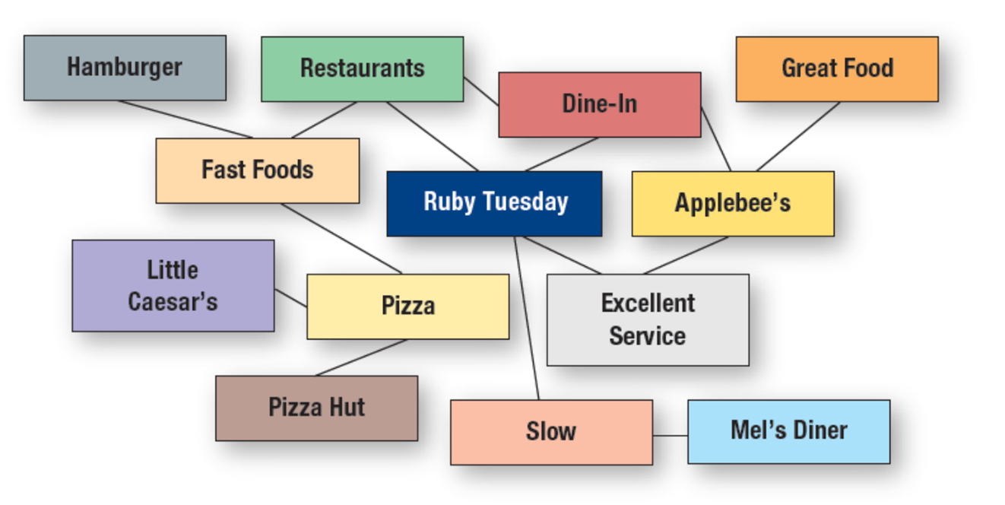
Figure 3.4: A Hypothetical Cognitive Map for Ruby Tuesday
Notes:
Cognitive maps are simulations of the knowledge structure and memories embedded in an individual’s brain. These structures contain a person’s assumptions, beliefs, interpretations of facts, feelings, and attitudes about the world around them. These thoughts interpret new information and determine a response to fresh information or a novel situation. This map is a crude illustration of the structure of the brain and the many linkages that are present. This represents one individual’s cognitive map of Ruby Tuesday. Ideas connected to Ruby Tuesday are restaurants, dine-in, excellent service, and slow. When the person thinks of slow, they immediately think of Mel’s Diner. When the person thinks of restaurants, fast foods come to mind, then pizza, then Pizza Hut and Little Caesar’s. It is easy to see from this illustration how concepts, thoughts, and ideas are all interconnected in our brains.
The cognitive map shows connections between concepts as follows.
Hamburger is connected to fast foods
Restaurants are connected to fast foods, Ruby Tuesday, and dine in
Dine in is connected to Ruby Tuesday and Applebee’s
Applebee’s is connected to great food and excellent service
Ruby Tuesday is connected to excellent service and slow
Mel’s diner is connected to slow
Fast foods are connected to pizza
Pizza is connected to pizza hut and Little Caesar’s

Slide 21
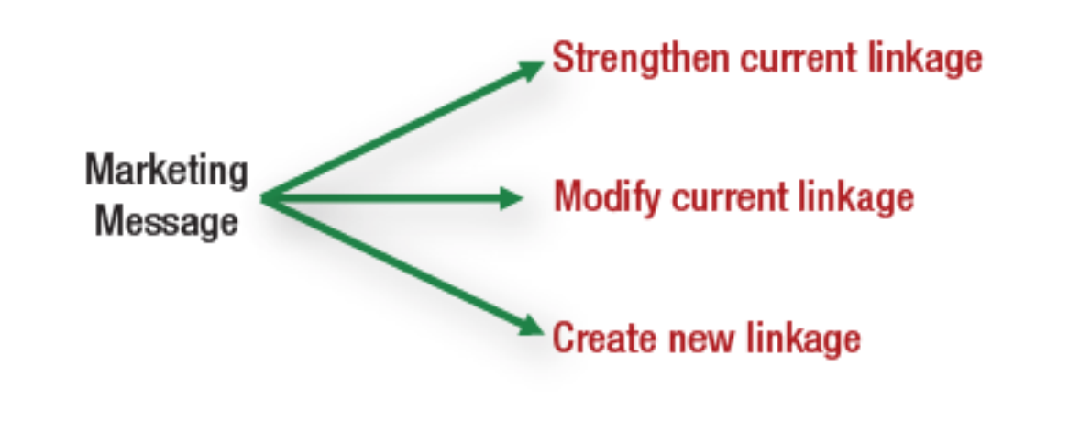
Figure 3.5: The Role of Marketing Messages in Cognitive Mapping
Notes:
Marketing messages have three roles when it comes to cognitive mapping. First, the message may be designed to strengthen current linkages. Second, it may be designed to modify current linkages. Third, it may create new linkages. Adding new linkages or modifying current linkages is more difficult than strengthening current linkages.
A diagram shows the marketing message expanding into three other concepts as follows, strengthen current linkage, modify current linkage, create new linkage.

Slide 22
Principles of Cognitive Mapping
Cognitive mapping enhances movement of messages from short-term to long-term memory
Most persuasive messages reinforce current linkages
Repetition necessary to establish new linkages
Modifying or creating new linkages is difficult
Notes:
Cognitive mapping helps explain how consumers process information and how messages are moved from short-term memory to long-term memory. Most persuasive messages reinforce current linkages, which is the easiest task for marketers. Establishing new linkages is more difficult. It requires repetition. Just like repeating a phone number several times helps move the number from short-term to long-term memory, seeing an advertisement message a number of times helps establish new linkages. It is difficult to modify and create new linkages. It takes time.

Slide 23
Evaluation of Alternatives
The Evoked Set Method
The Multiattribute Approach
Affect Referral
Notes:
The third step in the buying decision-making process is the evaluation of alternatives. Three models portray the nature of the process: the evoked set approach, the multiattribute approach, and affect referral. Understanding how consumers evaluate choices enables the firm’s marketing team to develop more effective materials.

Slide 24
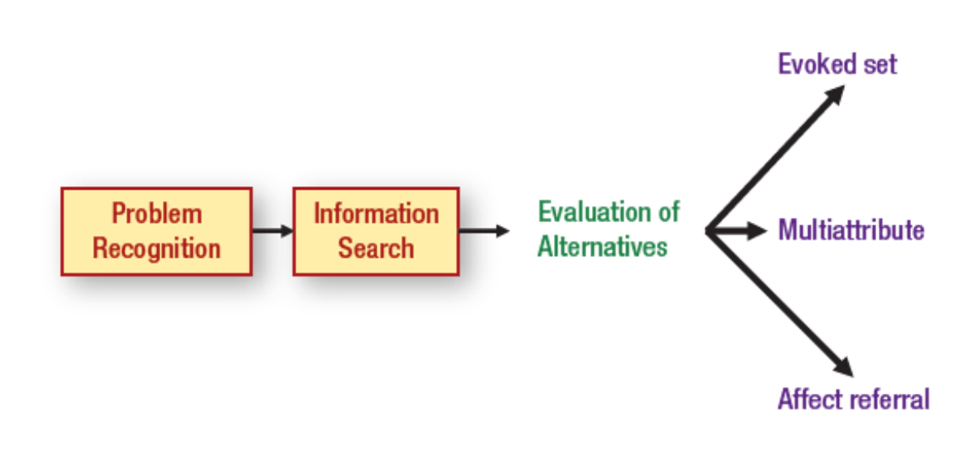
Figure 3.6: Methods of Evaluating Alternatives
Notes:
The third stage of the consumer decision-making process is the evaluation of alternatives. Understanding how consumers evaluate brands and products is important for creating effective marketing messages. Three models illustrate the nature of evaluation of alternatives: evoked set, multiattribute, and affect referral.
The process diagram’s structure and flow from left to right are as follows.
Problem recognition
Information search
Evaluation of alternatives
Evoked set
Multiattribute
Affect referral

Slide 25

The Evoked Set Method
Evoked set
Inept set
Inert set
Notes:
The evoked set consists of brands that an individual considers in making a purchase decision. Evoked sets are often generated internally during the information search stage of the process. It consists of brands the consumer is aware of and would consider purchasing, often brands that the consumer has used in the past. Two other sets of interest to marketers are the inept and inert sets. The inept set are the brands the consumer will not purchase, either because of a bad personal experience or information received from another source. It may be something someone told them. The inert set are brands the consumer does not know anything about or has so little information a judgment cannot be made. If a brand is in a consumer’s inert set, the goal is to transfer it to the evoked set because in most purchase situations, only brands in the evoked set will be considered. For instance, if a consumer decides to dine out, in most cases, only brands in the evoked set will be considered.
In this print advertisement, the marketing team for Sonos seeks to move the Sonos One with Amazon Alexa speaker into the evoked sets of consumers.

Slide 26
Questions to Consider (2 of 2)
How important is it for each of the following brands to be a part of a consumer’s evoked set?
Guess (jeans)
Advil (pain medicine)
Head & Shoulders (shampoo)
Black & Decker (power tools)
C & H (sugar)
Smith & Kline (attorneys)
Halls (cough drops)
Song Li (neurosurgeon)
Notes:
If consumers are not likely to conduct an external search for information, then being in the evoked set becomes more important. Also, for lower-involvement type products, being part of the evoked set is important because consumers will not spend a great deal of time evaluating alternatives. The less time spent in the evaluation of alternatives, the more important it is to be part of the evoked set. Also, if a brand wants to develop a high level of brand equity with consumers, it starts with being in the evoked sets of individuals.
Answers will vary among students on how important the evoked set would be for these brands. Certainly, for an attorney or neurosurgeon, being part of the evoked set is not too important since people will very likely do a more extensive search for information.

Slide 27
The Multiattribute Approach
Used for high-involvement purchases
Consumer attitude is determined by:
brand’s performance for each attribute
Importance of each attribute to consumer
The higher a brand rates on important attributes, the more likely it will be purchased
Notes:
The multiattribute approach is used for high-involvement purchases, such as vehicles. With the multiattribute approach, the evaluation is based on two dimensions: 1) the brand’s performance on product or brand attributes and 2) the importance of each attribute. The higher that a brand rates on attributes that are important to consumers, the more likely the brand will be chosen. It would be extremely rare for a brand to score the highest on all attributes. Instead, there are tradeoffs. In purchasing a car, not one single automobile is likely to have every feature the consumer wants, especially if the auto is being purchased from a dealer’s lot and not being ordered. The same is true for purchasing a home. Consumers must make tradeoffs. The final choice comes down to the brand that offers the most features desired by consumers. While consumers aren’t likely to do this mathematically on paper, they will conduct a simulated approach by mentally comparing one brand against another on various attributes.

Slide 28
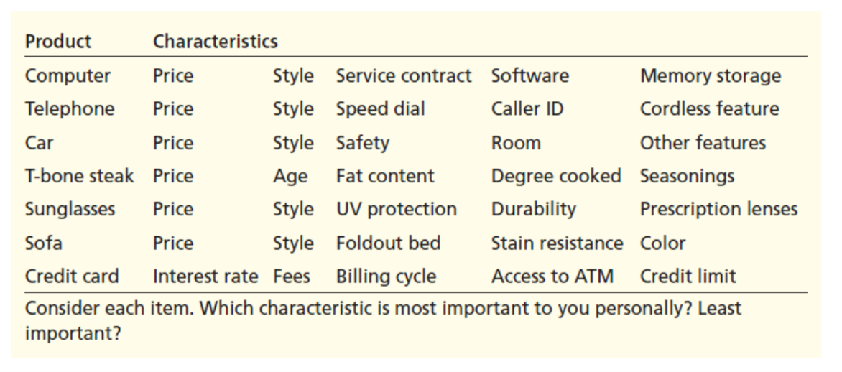
Figure 3.7: Product Attributes That May Be Important in a Multiattribute Approach
Notes:
The table caption reads, consider each item, which characteristic is most important to you personally? least important? The table has columns from left to right labeled product, characteristics. The table contents are from top to bottom as follows:
Computer, price, style, service contract, software, memory storage
Telephone, price, style, speed dial, caller I D, cordless feature
Car, price, style, safety, room, other features
T bone steak, price, age, fat content, degree cooked, seasonings
Sunglasses, price, style, U V protection, durability, prescription lenses
Sofa, price, style, foldout bed, stain resistance, color
Credit card, interest rate, fees, billing cycle, access to A T M, credit limit

Slide 29

Affect Referral
Saves mental energy
Multiattribute approach might have been used for previous purchases
Consumers often develop emotional bonds with brands
Notes:
Affect is the third part of attitude. It deals with emotions and feelings. With the affect referral method, consumers purchase the brand they like the best. There may not even be a strong reason they like the brand – they just do – or they may have a strong emotional attachment to the brand for some reason. It may have been a brand their parents used, so they developed an emotional attachment. The affect referral method saves energy. Consumers don’t have to think about the other brands or consider other alternatives; they just purchase the brand they like. It’s possible that the multiattribute approach was used in the past to determine the best brand, so the process does not have to be repeated. The experience with the brand was positive, so consumers continue buying it and over time develop a stronger emotional bond with it. In this ad, loyal patrons of Stevi B’s Pizza Buffet may use the affect referral method in evaluating pizza restaurants.

Slide 30
Figure 3.8: Trends Affecting Consumer Buyer Behaviors
Age complexity
Gender complexity
Active, busy lifestyles
Diverse lifestyles
Communication revolution
Experience pursuits
Health emphasis
Notes:
Studying the steps consumers take while making purchasing decisions helps us to create effective marketing communications. The environment in which consumers make purchases continually changes and evolves. Here, we can see trends in the consumer buying environment that affect purchasing patterns.

Slide 31
Figure 3.9: Marketing Responses to Changing Trends in the Consumer Buying Environment
Monitor consumer environment for changes
Create goods and services that are compatible with the changes
Design messages that reflect the changes
Notes:
Understanding consumer buyer behavior trends is important. Companies need to respond to these changes in buying behaviors. The first step is to monitor the consumer environment and note especially any changes in patterns of behavior. The second step is to create goods and services that are compatible with these changes. Third, marketing messages that reflect these changes should be designed.

Slide 32
Business-to-Business Buyer Behaviors and Influences
Buying center: a group of individuals making a purchase decision on behalf of a business
Purchasing roles:
Users
Buyers
Influencers
Deciders
Gatekeepers
Notes:
In the business-to-business sector, people still make purchase decisions. The process that is used is different, which means marketers will have to use a different approach. Often more than one person is involved in the decision. Further, corporate policies can restrict decisions and decision rules can affect purchase activities. Factors such as costs, quality, and profit margins will also influence the decision.

Slide 33

Organizational Influences
Company goals and operating environment
Finances, capital assets, market position
Quality of human resources
Country in which the firm operates
Notes:
Studies of organizational decision making indicate that employees tend to adopt heuristics, or decision rules that reduce the number of viable options to a smaller, manageable set. Company goals, rules, budgets, and other organizational factors create heuristics. One frequently used decision rule, knows as “satisficing,” occurs when the team identifies an acceptable alternative.

Slide 34
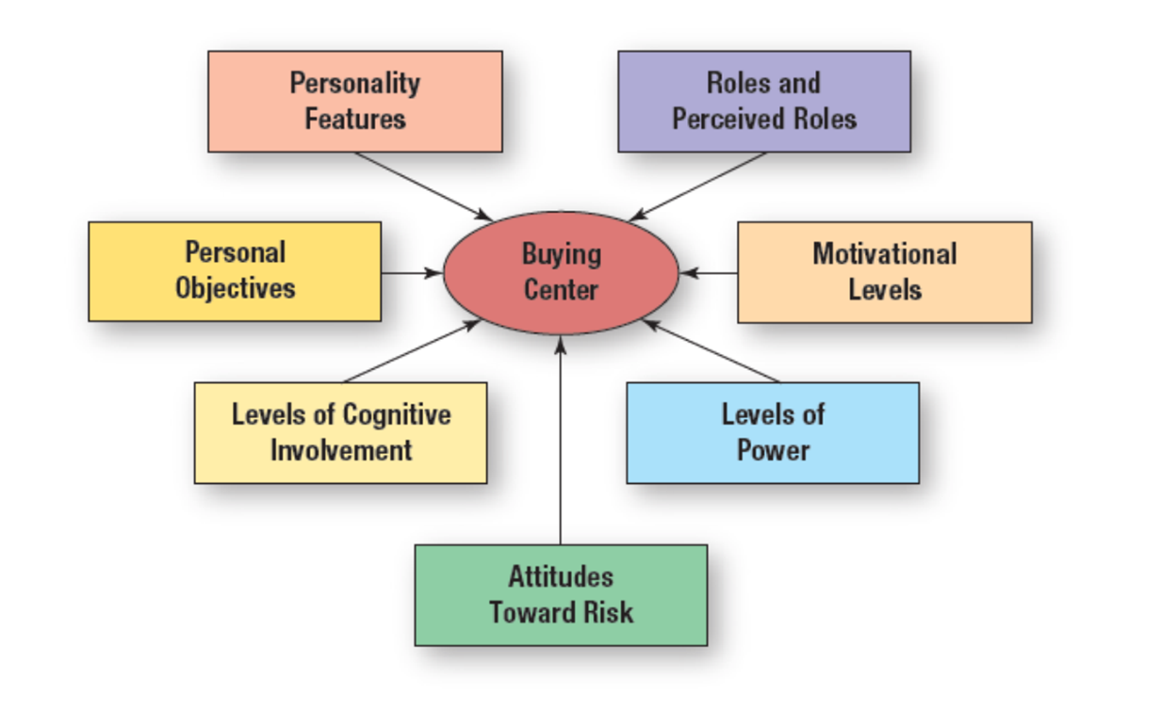
Figure 3.10: Individual Factors Affecting Members of the Buying Center
Notes:
Because members of the buying center are people, there are a number of individual factors that influence the buying process. The buying center becomes a very complex social organization when a number of people become involved in buying decisions. Personalities, ambitions, and personal agendas may cause conflict and tension. When individuals’ jobs are affected, they tend to become more involved.
The central topic of the diagram is the buying center, which is surrounded by an outer circle comprised of connected topics.
The connected topics as follows.
Personality features
Roles and perceived roles
Motivational levels
Levels of power
Attitudes toward risk
Levels of cognitive involvement
Personal objectives

Slide 35
Individual Factors Affecting Buying Centers (1 of 2)
Personality
Decisive person
Extrovert
Introvert
Roles
Individual’s age, heredity, ethnicity, gender
Socially constructed
Motivation
Match individual’s goals to organization’s goals
Notes:
The personality of individuals will affect the purchase decision and the buying center. A decisive person will be more involved and direct. An extrovert will spend more time talking, while an introvert will be too timid to speak. The roles people have within the organization will impact the buying center. Roles are socially constructed and also influenced by a person’s age, heredity, ethnicity, gender, and cultural membership. A person’s degree of motivation depends on the match between the individual’s personal goals and the goals of the organization. Goals to succeed within an organization usually translate into greater involvement.

Slide 36
Individual Factors Affecting Buying Centers (2 of 2)
Level of power
Role in buying center
Official position
Impact of decision on personal performance
Risk
Risk avoiders
Levels of cognitive involvement
Cognitive capacity
Personal objectives
Notes:
People derive their level of power from official and unofficial roles within an organization. The more power an individual has, the more he/she will be involved. Roles may be defined by the buying center and the impact the decision has on an individual’s personal performance. Risk and the attitude toward risk is important. A risk aversive person will seek a safe path and may want to stay with the current vendor. Levels of cognitive involvement will vary. The higher the level of involvement, the more questions individuals will ask and the more active they will be in the process. Individuals who have a higher level of cognition will spend more time asking questions and talking. The last factor is personal objectives. Individuals may act within a buying center in such a way that will promote individual objectives over company objectives, but in a way that is not noticed by others.

Slide 37
Types of Business-to-Business Sales
Straight rebuy: firm previously chose a vendor and places a reorder
Modified rebuy: buying team considers and evaluates alternatives
New task buy:
Considering purchase for first time
Time passed since previous purchase
Buyers have little or no experience
Notes:
Buying decisions can be classified into three categories: straight rebuy, modified rebuy, and new task buy. With a straight rebuy, the current vendor is contacted and a new order is placed. Alternatives are not considered. With a modified rebuy, a company is open to new vendors and will evaluate the current vendor as well as new possibilities. A new task is when a company is making a purchase for the first time or with little or no experience. It does not occur frequently, so often the vendors help in the process.

Slide 38
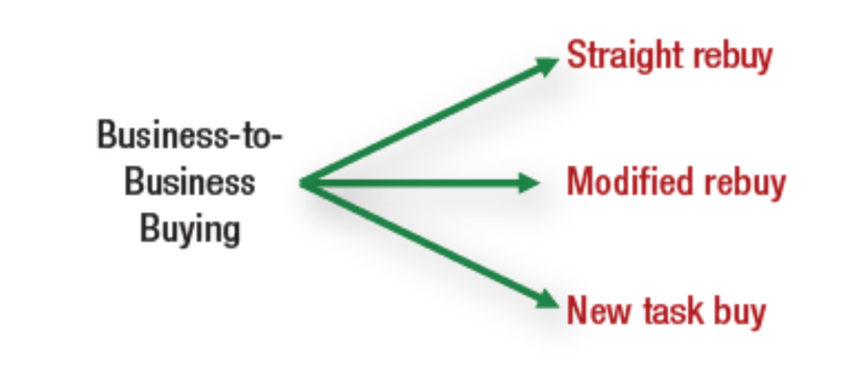
Figure 3.11: Types of Business-to-Business Buying Situations
Notes:
The diagram shows the concept of business to business buying, branching out into three topics as follows, straight rebuy, modified rebuy, new task buy.

Slide 39
Figure 3.12: Reasons to Make a Modified Rebuy
Dissatisfaction with current vendor
A different vendor makes an attractive offer
End of contractual arrangement with current vendor
Individuals involved in decision process have little or no experience with the product
Notes:
Modified rebuys occur for four different reasons. The company already has a current vendor, but has chosen to look at additional vendors and solutions. Reasons for moving from a straight rebuy to a modified rebuy include the following.
The company is dissatisfied with the current vendor.
Another vendor has made some type of attractive offer and members of the buying center feel it is worth looking at again. It may be a lower price, better quality, or some other factor that makes the buying center open it up for evaluation again.
Companies will often take bids at the end of contracts with vendors. They may stay with the current vendor, or they may not.
The individuals making the decision have little or no experience and rather than stay with the current vendor, they want to see what other vendors can offer. There may be features the current vendor is not supplying.

Slide 40
The Business-to-Business Buying Process
Identification of needs
Establishment of specifications
Identification of vendors
Vendor evaluation
Vendor selection
Negotiation of terms
Postpurchase evaluation
Notes:
The first step in the b-to-b buying process is the identification of needs. It may be a need for raw materials, or a new vehicle, or even new land. Step 2 is to establish objectives. It is important to do this before vendors are contacted to ensure the decision is unbiased. Step 3 involves identifying possible vendors or sending out a request for proposals. Once vendors have submitted bids, evaluation begins. Members of the buying center will screen out vendors who do meet the specifications. Depending on the size of the bid, this process of evaluation may take just a few hours to several weeks. Once the vendor has been selected, terms are negotiated. Evaluation of the vendor then occurs after the purchase. With business purchases, it often becomes a continuous process with repeat orders, the straight rebuy situation.

Slide 41
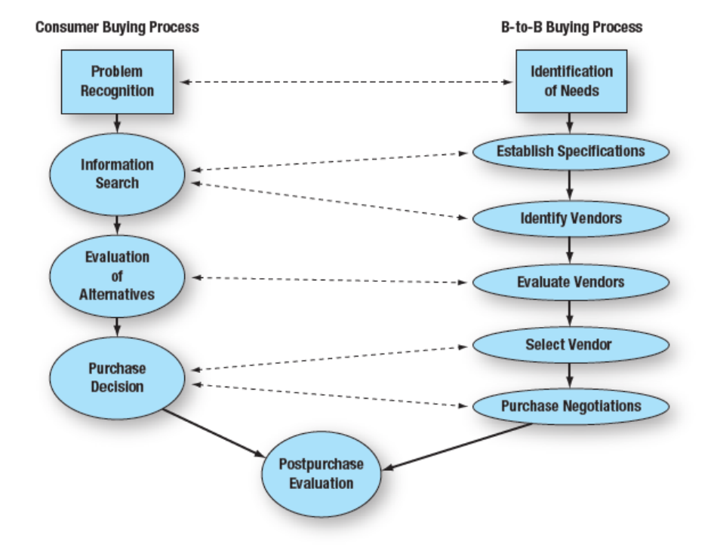
Figure 3.13: A Comparison of the Business-to-Business Buying Process to the Consumer Buying Process
Notes:
The business-to-business buying process is very similar to the individual buying process. Both have a problem recognition that starts the process. Information search for individuals is similar to establishing objectives and identifying vendors in the b-to-b. Both processes involve an evaluation of alternatives. The purchase decision in the consumer process is split into vendor selection and purchase negotiations for businesses. Finally, both involve a postpurchase evaluation stage.
A diagram has two columns labeled consumer buying process and b to b buying process, each with topics flowing from top to bottom which converge at the post purchase evaluation.
The structure of the columns is as follows.
Consumer buying process
Problem recognition
Information search
Evaluation of alternatives
Purchase decision
B to b buying process
Identification of needs
Establish specifications
Identify vendors
Evaluate vendors
Select vendor
Purchase negotiations
The connections of the concepts are as follows.
Problem recognition connected reciprocally to the identification of needs
Information search connected reciprocally to establish specifications and identify vendors
Evaluation of alternatives connected reciprocally to evaluate vendors
Purchase decision connected reciprocally to select vendor and purchase negotiations
Purchase decision and purchase negotiations connected reciprocally to post purchase evaluation

Slide 42

Dual Channel Marketing
Products sold in both consumer and business markets
Spin-off sales can occur
Marketing decisions: how to represent product in each channel?
Notes:
Dual channel marketing involves selling products to both consumer and business markets. The process often begins with the B-to-B market. Individuals like a brand they are using at work and purchase the brand for personal use, which is spin-off sales. It may be the brand of computer, vehicle, or cell phone. The challenge for marketers is should they market both channels the same way, or should they be different? There are also image issues to consider. This advertisement for Alpha Air One appeals to both individual consumers and business customers.

Slide 43
Figure 3.14: Dual Channel Marketing Strategies
Use different communication messages
Create different brands
Use multiple or different channels
Notes:
Dual channel marketing requires one of three approaches based on how the product is purchased and used. 1) The same brand is sold in both markets, but the communication messages are different. This often requires having different marketing plans. 2) A second approach is to create different brand names and a different marketing plan for each brand. With this approach involves two totally separate approaches and is motivated by the idea that the consumer and business markets are not compatible. 3) With the last approach, multiple or different channels of distribution are used for the consumer market and b-to-b market. In most cases, this approach involves different brands as well.

Slide 44
International Implications
A cultural assimilator is a valuable team member
Must understand nuances of purchasing process
Build a powerful brand
Create a visible global brand presence
Notes:
Buyer behaviors vary widely around the world. A cultural assimilator is a valuable person to have on staff to assist in marketing plans for other countries. It is important to understand the purchase process. The way products are purchased in the U.S. is not the same as it is in Japan, Brazil, or other parts of the world. Having a strong brand name helps with global expansion. Even for B-to-B markets, global brands are important.

Slide 45
Your Career: Buyer Behaviors and Career Choices
Time and effort spent on external search related to:
Motivation to search
Ability to search
Cost versus benefits of search process
Organizational, individual factors in the B-to-B buying process are important
Consider your level of cognitive involvement and personal objectives
Notes:
Let’s take another look at the personal values shown in Figure 3.3. These often exert an impact on the type of position or occupation a graduate seeks. In most cases, job seekers use the multiattribute approach to evaluate various companies and job possibilities. It is unlikely someone will find the type of work or company that scores high on every factor.

Slide 46
Blog Exercises
Buyer Behaviors for New and Adapted Services
Millennials and Buyer Behaviors
Lingerie and Buyer Behaviors
Notes:
The blog exercises for Chapter 3 include Buyer Behaviors for New and Adapted Services, Millennials and Buyer Behaviors, and Lingerie and Buyer Behaviors. Links are embedded in the text for each.

Slide 47

Copyright
This work is protected by United States copyright laws and is provided solely for the use of instructors in teaching their courses and assessing student learning. Dissemination or sale of any part of this work (including on the World Wide Web) will destroy the integrity of the work and is not permitted. The work and materials from it should never be made available to students except by instructors using the accompanying text in their classes. All recipients of this work are expected to abide by these restrictions and to honor the intended pedagogical purposes and the needs of other instructors who rely on these materials.

